Slide 1

Azure Governance Design and Deployment with the Azure Landing Zone Bicep Repository
Jan-Tore Pedersen
Principal Consultant
Spirhed AS Norway
Level: Intermediate

Slide 2
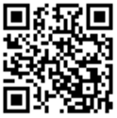
Session Survey
Your feedback is very important to us
Please take a moment to complete the session survey found in the mobile app
Use the QR code or search for “Converge360 Events” in your app store
Find this session on the Agenda tab
Click “Session Evaluation”
Thank you!

Slide 3
Azure Governance
ALZ
ALZ Bicep
Subscription Vending
Lot’s of demos

Slide 4
Feel free to ask questions

Slide 5
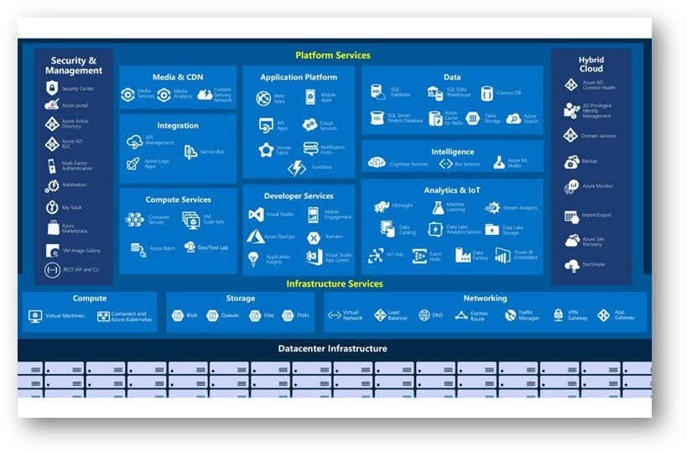
The Azure Jungle

Slide 6
So what is Azure Governance

Slide 7
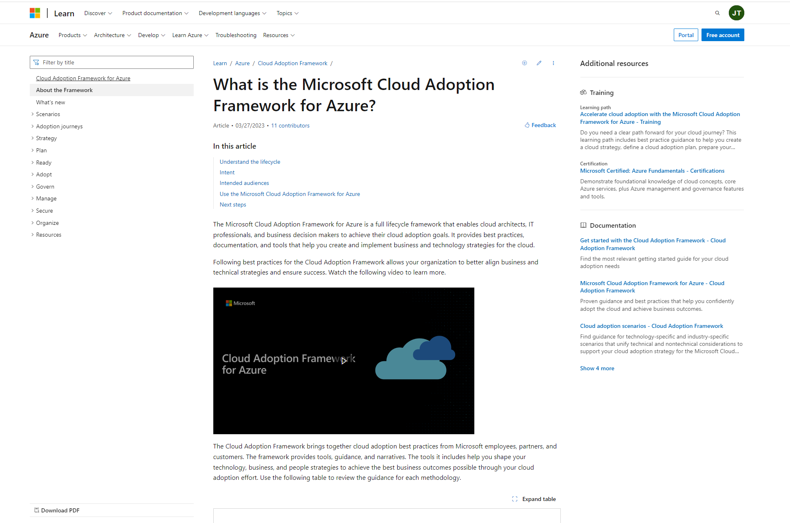
Cloud Adoptation Framework
https://learn.microsoft.com/en-us/azure/cloud-adoption-framework/overview

Slide 8
Microsoft Cloud Adoption Framework for Azure
Define strategy
Define motivations, and create a business case leveraging cloud economics
Plan
Create actionable cloud adoption plan aligned to the strategy
Ready
Prepare cloud environments with Azure landing zones
Adopt
Migrate or Innovate
Design, build and deploy workloads to Azure
Govern
Automate governance baseline and empower delegated responsibility
Manage
Build operations baseline and support enterprise operations
Secure
Establish security baseline and manage security posture

Slide 9
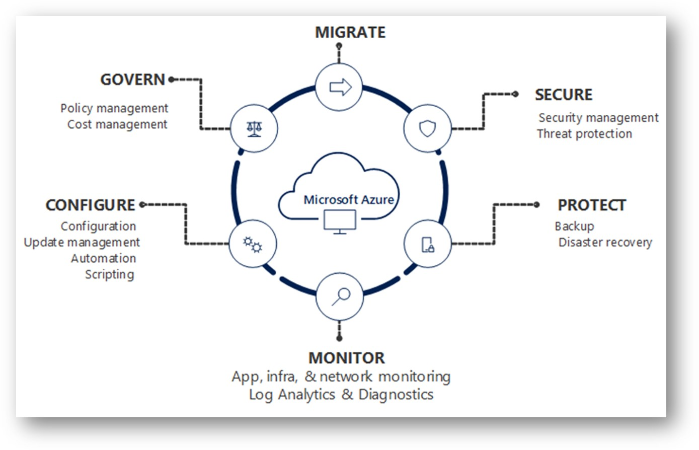

Slide 10
Azure Landing Zone

Slide 11
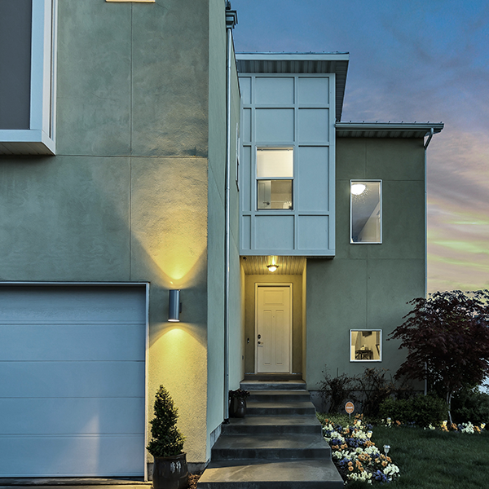
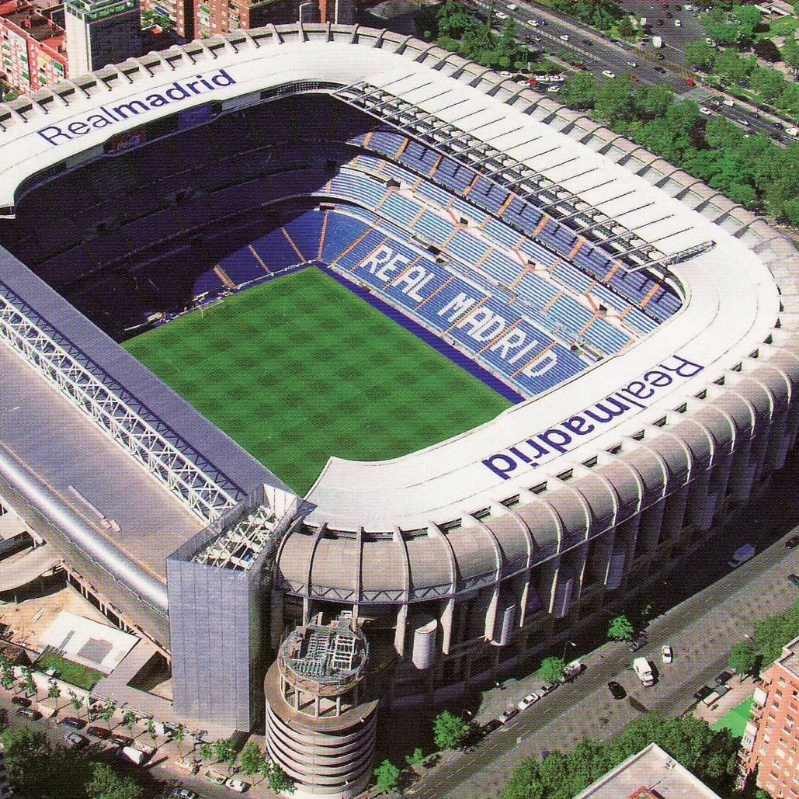

What are you building? Your cloud foundation supports the construction of a—
House
Stadium
Bridge
Notes:
Building a cloud environment like constructing a building—a house, stadium, or bridge.
The structure you’re going to build will determine your approach and architectural style.
Depending on the structure, the foundations may vary.
However, there will be common items across the various foundations.
This is also true in the cloud.
The cloud foundations may vary depending on your requirements, or the scale you need for your environment
but just like construction foundations will start with concrete and steel, cloud environments will also share common starting elements.
Which is where a landing zone comes. Let's look at what purpose they serve.

Slide 12
What are landing zones for?
Starting a journey based on best practices with a start-to-finish plan is a key factor for success
Creating well-designed foundations for a cloud environment will enable the safe adoption of new technologies, at pace
Using consistent, repeatable environment designs helps scaling out in a manageable way
Baking in repeatable best practices into environment deployments
Factoring your team's technical skills into environment planning
Notes:
A landing zone is intended to help start an environment build from strong foundations.
Best practices
Repeatable to ensure standardization
Consider technical skills of the team and their learning plans as part of the decisions you take in planning your landing zone.
Let's look at the benefits landing zones can provide for your organization.

Slide 13
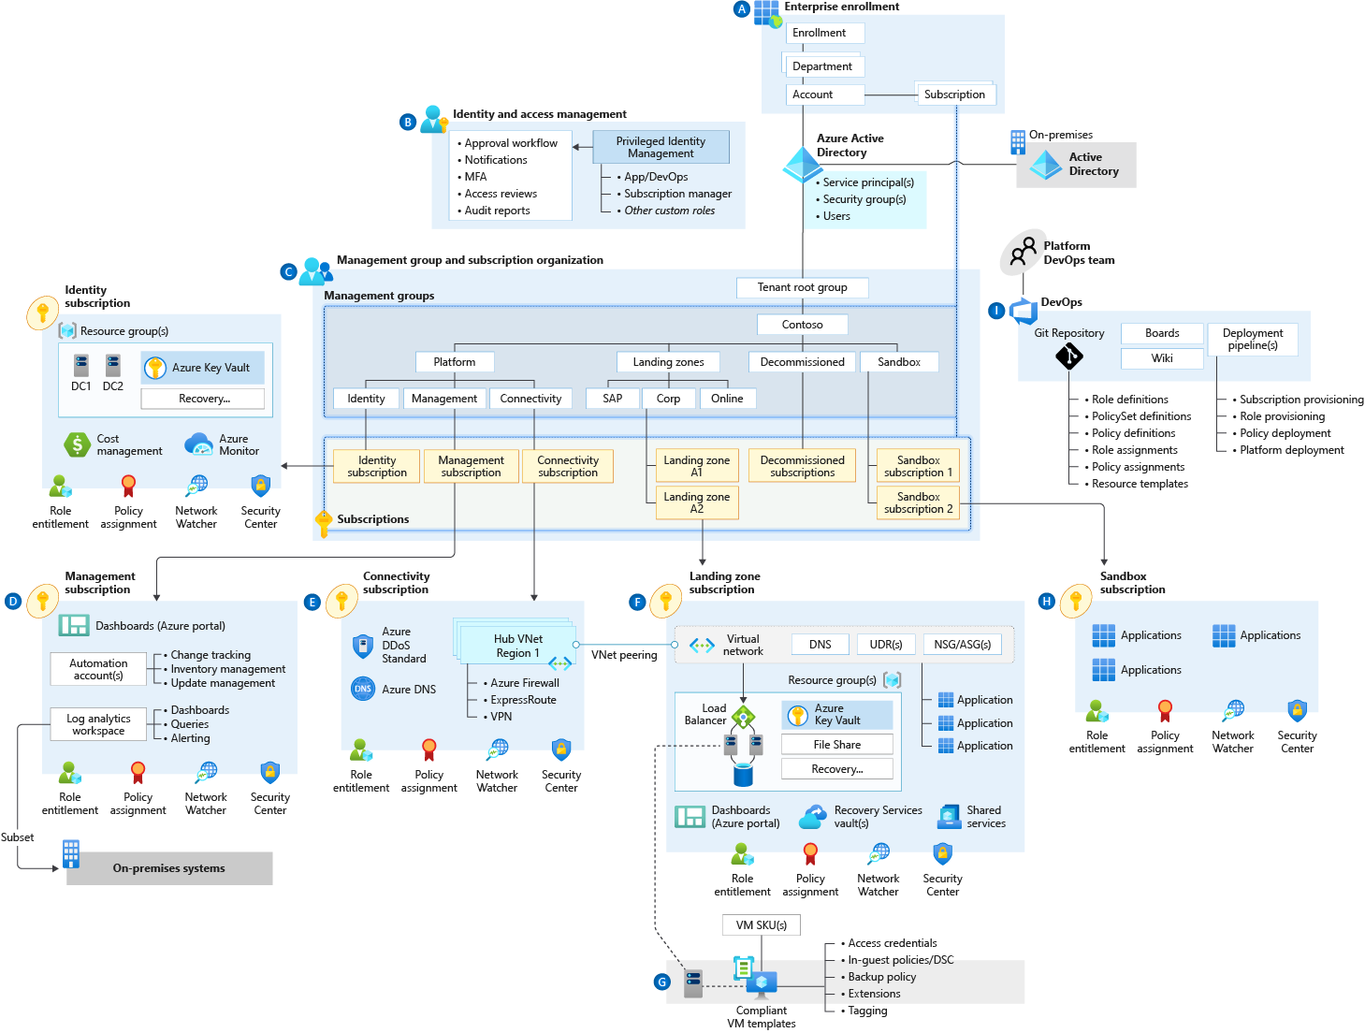
Azure landing zone conceptual architecture What does it represent?
Target end-state for most organizations
Scaled-out and mature environment
Customer and partner practices for environment design across Microsoft
Strong foundation for management, governance, and security processes
Notes:
Azure landing zone conceptual architecture
The destination (or target end-state) of the journey.
Scaled-out controls and architecture to enable customers to grow and innovate safely
Depending on the cloud operating model chosen, you may arrive at this destination quickly, or over time.
This may represent a subset of your estate, if you scale into enterprise operations or distributed operations
We are learning from engagements with customers and partners, codifying best practices guidance for the cloud adoption journey.
Let's dive into common starting points, and the typical phases of a cloud journey.

Slide 14
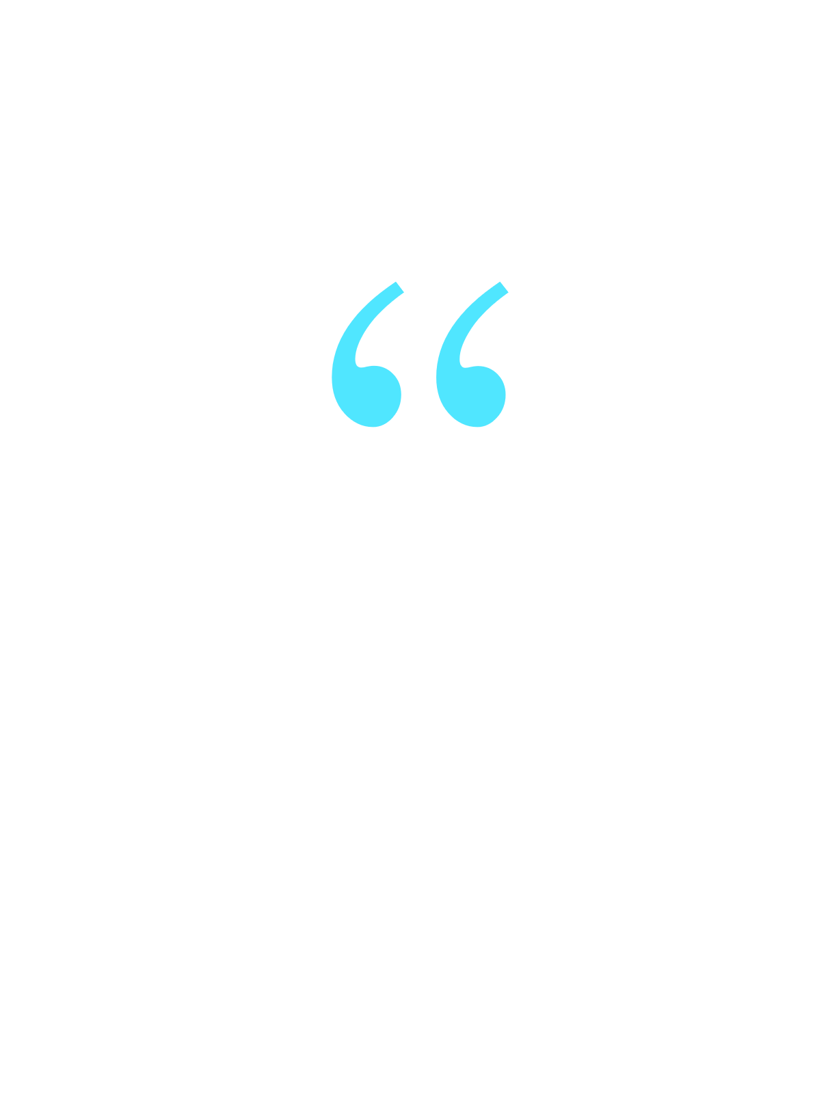
What is "greenfield development"? Developing a new environment without dependencies
Beginning of your cloud adoption journey
Your new cloud environment
No production workloads are deployed
Environment can be overwritten and workloads moved without business impact
No business processes are impacted by changes to operations, controls, or access
We have not deployed anything in Azure and want a start-to-finish plan based on best practices.
Notes:
For most organizations, greenfield development is the beginning of the cloud adoption journey.
Read through the points on the slide to illustrate the general idea of "greenfield."
What about organizations looking for the fastest route to provision a landing zone—
with governance and compliance guardrails in place?

Slide 15
Azure landing zone accelerators Fastest path to deployment
Microsoft Azure portal implementation experience
Based on Azure landing zone conceptual architecture
Quickly implement scaled-out governance and security
Deploy tested, best-practice configurations for key governance policies, processes, and tools
Notes:
Azure landing zone accelerators are a ready-made deployment experience for organizations where conceptual architecture fits with the operating model and resource structure you plan to use.
Azure-portal-based deployment to provide a full implementation of the conceptual architecture, along with key governance elements such as management groups and policies.
Let's look in detail at how accelerators can speed up your deployment experience.

Slide 16
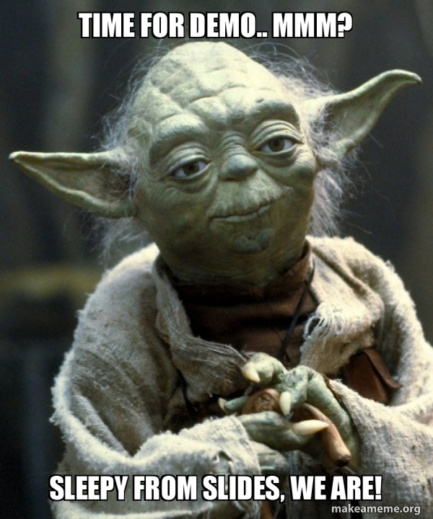
ALZ Bicep Repository

Slide 17

Azure landing zones Design areas
Azure billing & Active Directory tenant
Security
Identity & access management
Governance
ENVIRONMENT
COMPLIANCE
Resource organization
Management
Network topology & connectivity
Platform automation & DevOps
Notes:
Each different Azure landing zone implementation option provides a different path to deployment. Before choosing an implementation option, let’s review design areas
Enterprise enrollment: if you are making a commitment to use a specific amount of Azure, you'll want to consider how your EA enrollment is configured & ensure your Azure AD tenant is aligned.
Identity: Are you using your existing Azure AD tenant from Office 365 by applying RBAC? Or do you have deeper security requirements that require more considerations?
Resource organization: Get a jump on cloud governance by preparing for proper resource organization early. This includes things like naming, tagging, subscriptions, resource groups, and management groups. Good design now will make portfolio governance easier later
Network topology and connectivity are the two must have considerations. Until you understand how things connect to in the cloud & how people gain access, you can't really use the cloud
Business continuity and disaster recovery - BCDR provides the foundation for reliability and rapid recovery. BCDR isn't really a design area, its a discipline under CAF Manage. i don't generally talk to it as a pillar, even though its on the design areas page. if anything just a brief mention of it during the Operations baseline talking point.
Governance disciplines: Begin including the governance disciplines in every landing zone to get an early start on governance, security baseline, and compliance policies.
Deployment options: Azure landing zones provide a variety of deployment options to fit your operating model
Operations Baseline: Get a jump start on operations management (CAF Manage) by preparing each landing zone for visibility, operational compliance, and protect/recover processes.
Let's look at the core technical constructs your organization needs for successful Azure adoption.

Slide 18

When do you need customization?
In some scenarios, you can't use a ready-to-deploy implementation:
The implementation doesn’t represent how you operate services.
Your organization has specific controls you require for compliance.
The north star for Azure landing zones remains the conceptual architecture—which customers and partners can use to design and operate successful cloud environments.
We have recommended best practices guidance and tools—to help you deliver a customized experience to design and operate your environments.
Notes:
How do you know, as a customer, when you need customization?
With the first bullet, stress the scenarios when customers can't use a ready-to-deploy solution, and will need to customize their environment implementation
Emphasize the "target end-state" of the conceptual architecture as a signpost guiding customers towards successful design and operation of cloud environments.
What if you need a fully featured enterprise-scale implementation—with complete governance and management in place?

Slide 19
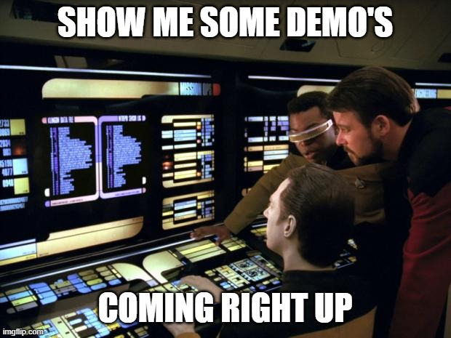

Slide 20
Azure Subscription Vending

Slide 21


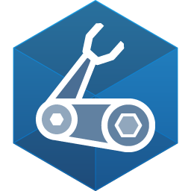
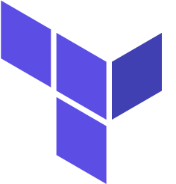
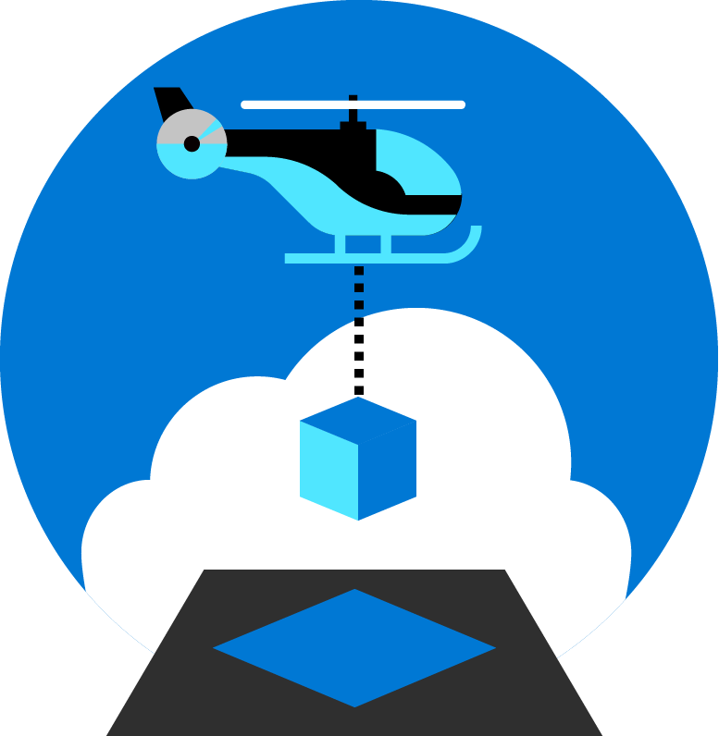
NEW: Landing zone vending!
Infrastructure as code to automate:
Subscription creation
Management group placement
Virtual networking
Role assignments
aka.ms/lz-vending/bicep
aka.ms/lz-vending/tf

Slide 22
Azure Landing Zone Customer Journey
Whether you are a Brownfield or Greenfield customer, if you are looking to implement a new ALZ environment based upon best practice then you will require multiple subscriptions created. The below articles will refer you to manual and programmatic creation methods.
Deploy Azure Landing Zone Platform components
To accelerate the deployment of individual landing zones within an Azure tenant, a subscription vending solution is recommended to help deploy a subscription and the core resources, e.g., networking. Subscription vending is available using both Terraform and Bicep.
There are multiple Landing Zone Accelerators that provide a specific architectural approach and reference implementation for preparing landing zone subscriptions for an enterprise deployment, e.g. Azure Virtual Desktop, SAP, AKS etc.. These Accelerators are available in a wide range of deployment options.
Bootstrap your environment
Accelerate the deployment of platform resources based upon ALZ conceptual architecture. Deployment options available via Portal, Terraform and Bicep to assist with the deployment of management group hierarchy, governance baseline, connectivity, management and security components.
Subscription (LZ) Vending Process
Landing Zone Accelerators
Create Platform
Subs
Create Platform
LZ Vending
Deploy Workload
Create Subscriptions Manually
ALZ Accelerator (Portal)
AKS
Accelerator
APIM
Accelerator
App Svc
Accelerator
LZ Vending Module
(Terraform)
Create Subscriptions Programmatically
Arc Servers
Accelerator
Arc K8S
Accelerator
SAP
Accelerator
Others…
ALZ Bicep Modules
ALZ Terraform Module
LZ Vending Module
(Bicep)
LZ Vending Modules
AVD
Accelerator
AVS
Accelerator
Cloud Scale Analytics
Accelerator
*Sequencing considerations

Slide 23
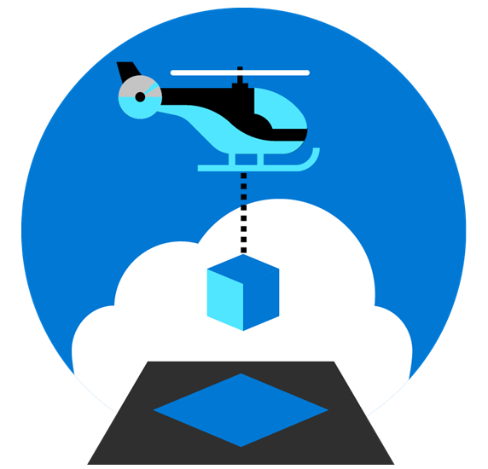
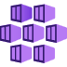















Example ALZ Customer Journey
Create Platform
Subs
Create Platform
Sub Vending
Deploy Workload
Create Subscriptions Manually
ALZ Accelerator (Portal)
Sub Vending Module
(Terraform)
AKS
Accelerator
APIM
Accelerator
App Svc
Accelerator
Create Subscriptions Programmatically
ALZ Bicep Modules
Sub Vending Module
(Bicep)
Arc Servers
Accelerator
Arc K8S
Accelerator
SAP
Accelerator
ALZ Terraform Module
AVD
Accelerator
AVS
Accelerator
Cloud Scale Analytics
Accelerator
Others…

Slide 24
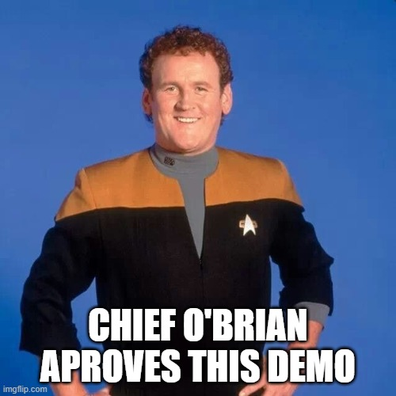

Slide 25
Thank You
Scripts and links bellow
https://github.com/jantorep/techmentor/alzbicep
https://aka.ms/adopt/landingzones
https://github.com/Azure/ALZ-Bicep

Slide 26
Session Survey
Your feedback is very important to us
Please take a moment to complete the session survey found in the mobile app
Use the QR code or search for “Converge360 Events” in your app store
Find this session on the Agenda tab
Click “Session Evaluation”
Thank you!

